Slide 1
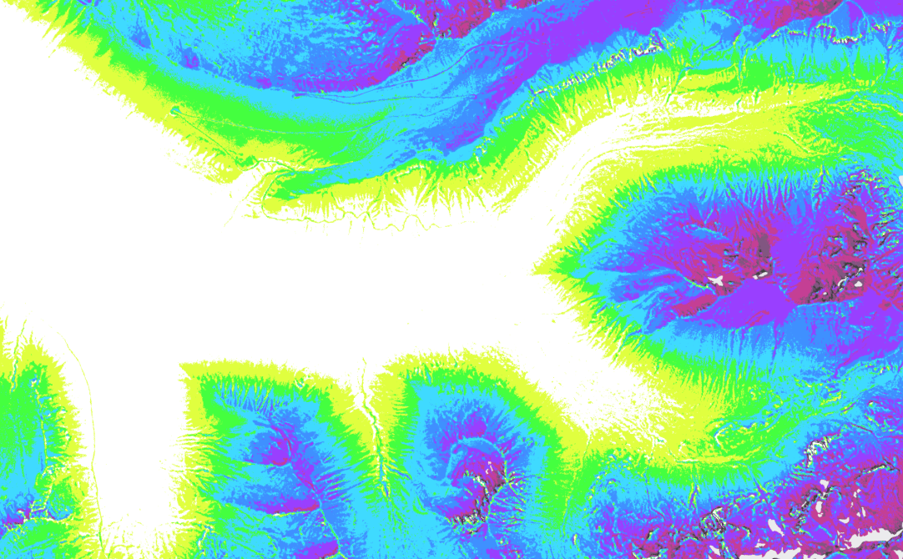
RMBL Spatial Data Science Webinar Series
Webinar 5: Spatial Prediction Using Remote Sensing
Ian Breckheimer, PhD
RMBL Staff Research Scientist
@ibreckhe | ikb@rmbl.org

Slide 2
Webinar Schedule
RMBL Spatial Data Science Webinar Series

Slide 3
Outline
Why should you use your field data to make maps?
Why?
What?
How?
What makes spatial prediction a unique challenge?
What core concepts do I need to know to succeed?
What is the basic workflow for spatial prediction?
What are some common missteps?
Case Study: vegetation deciduousness from imagery and LiDAR data.

Slide 4
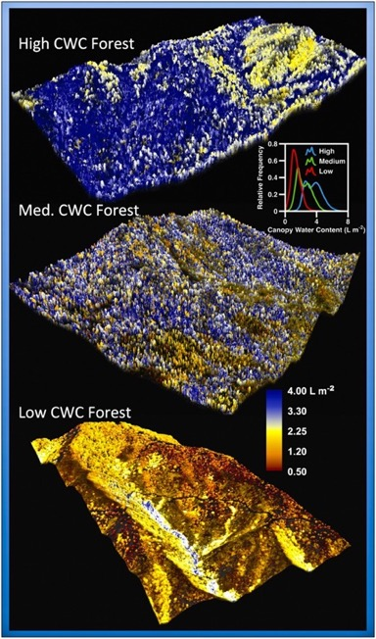
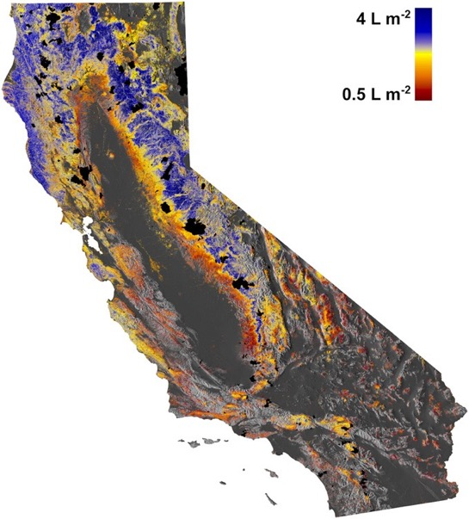
Why? Scaling up
Figures: Asner et al. 2016

Slide 5
Why? Filling in missing covariates
Figure: USA NPN

Slide 6
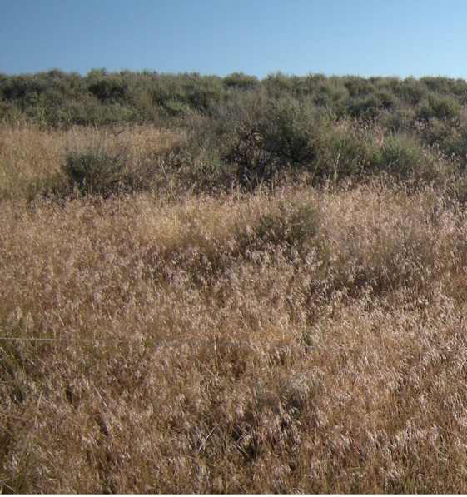
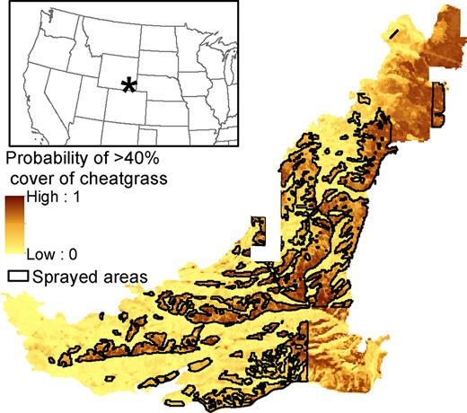
Why? Guiding field work
Images: Sofaer et al. 2019, CSU
Figure: Sofaer et al. 2019

Slide 7
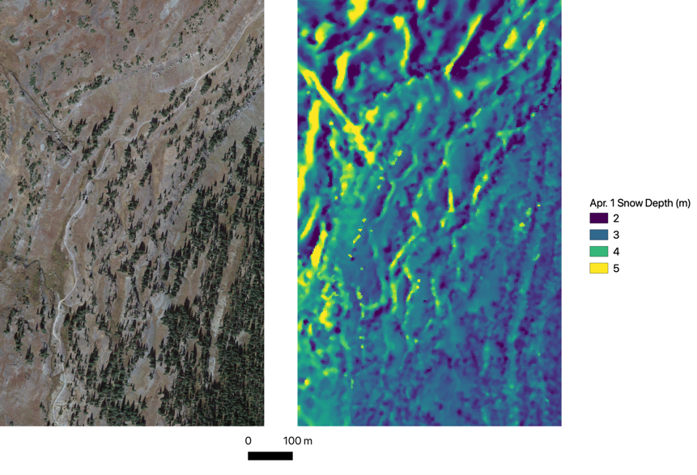
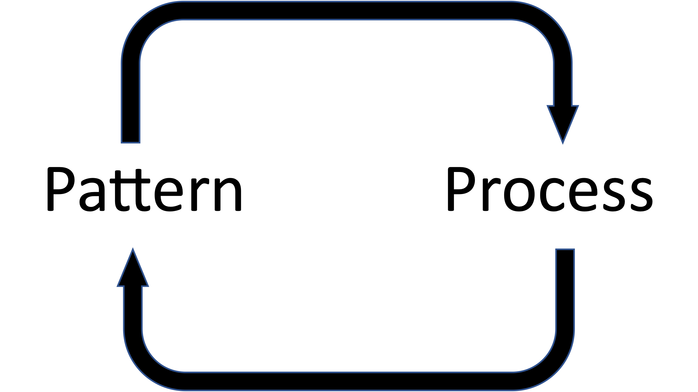
Why? Pattern-process relationships

Slide 8
Outline
Why should you use your field data to make maps?
Why?
What?
How?
What makes spatial prediction a unique challenge?
What core concepts do I need to know to succeed?
What is the basic workflow for spatial prediction?
What are some common missteps?
Case Study: vegetation deciduousness from imagery and LiDAR data.

Slide 9

Challenges: data volume
~47 million values
3448 rows ->
4592 columns ->
x 3 bands

Slide 10
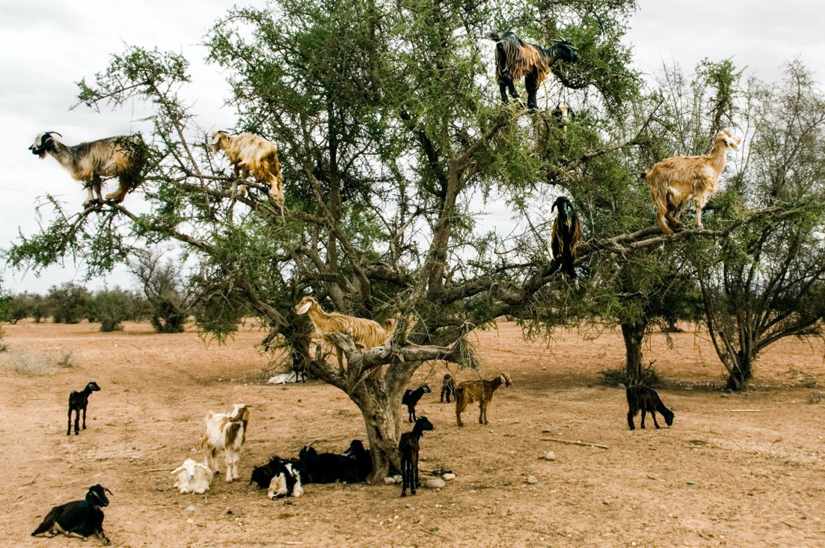
Challenges: interpolation and extrapolation
Image: NPR

Slide 11
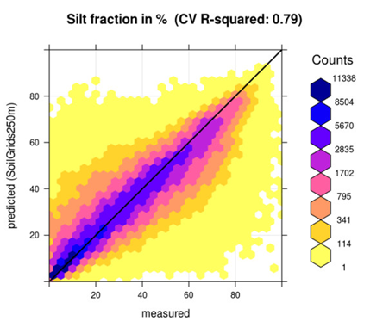
Challenges: dealing with uncertainty
Images: soilgrids.org, Hengl et al. 2017

Slide 12
Outline
Why should you use your field data to make maps?
Why?
What?
How?
What makes spatial prediction a unique challenge?
What core concepts do I need to know to succeed?
What is the basic workflow for spatial prediction?
What are some common missteps?
Case Study: vegetation deciduousness from imagery and LiDAR data.

Slide 13

Core concept: inference vs prediction
Inference
Prediction
Is this pattern real?
What’s causing it?
Is this pattern useful?
How stable is it?

Slide 14
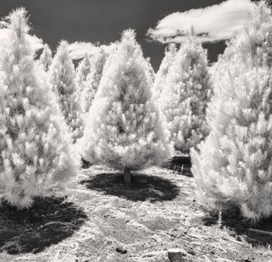
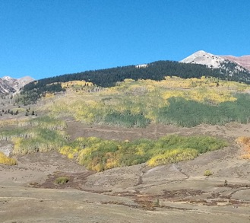
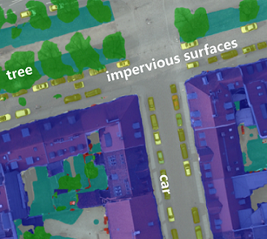
Core concept: features (predictors or covariates)
Spectral Features
Structural Features
Semantic Features
Temporal Features
Images: Lisa Kimmorly, Millikan et al. 2019, GroundAI

Slide 15
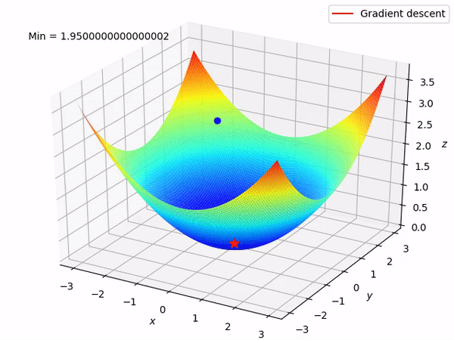
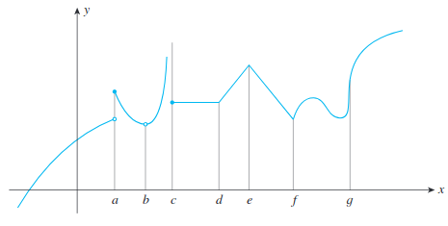
Core concept: loss function
Loss functions encode goals
Loss = “badness”
Loss functions must be differentiable
Images: Athimung S, Applied Calculus, 8th ed

Slide 16
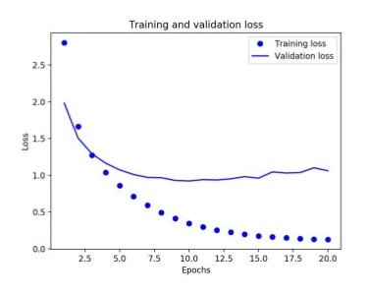
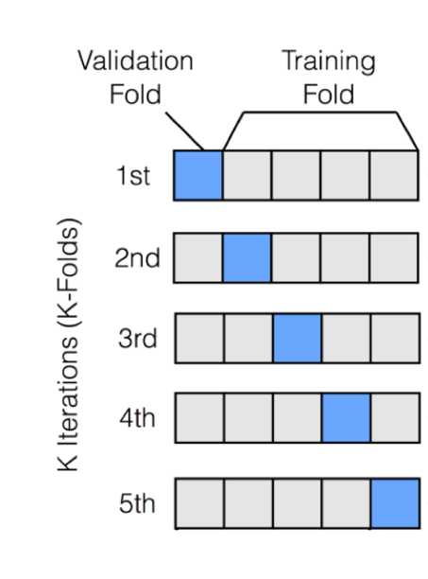
Core concept: fitting and overfitting
Cross-validation
Overfitting
Images: Yash Kandewahl

Slide 17
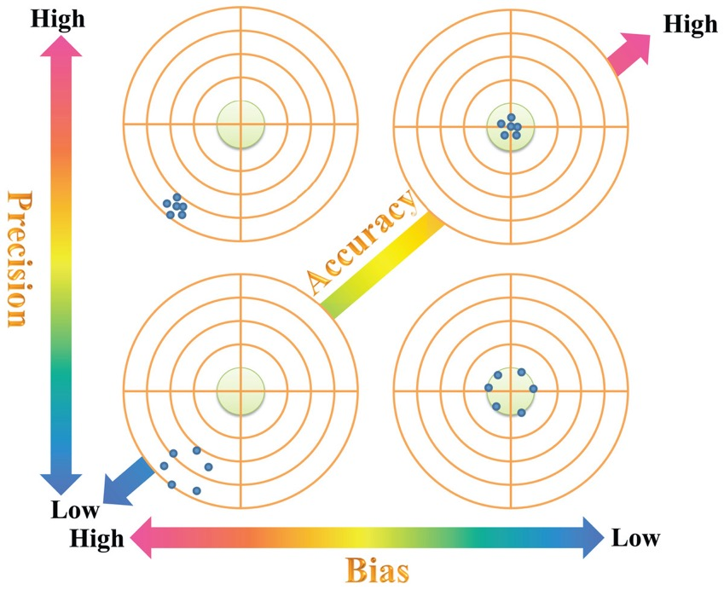
Core concept: precision and bias
Image: Chen et al. 2018

Slide 18
Core concepts summary
Machine learning models use features to learn a task and make predictions by minimizing a loss function. They don’t care about statistical significance.
These models are really good at making predictions on training data, but can overfit. This means you always want to evaluate a model on independent data, sometimes by cross-validation.
An accurate model gives precise and unbiased predictions.

Slide 19
Outline
Why should you use your field data to make maps?
Why?
What?
How?
What makes spatial prediction a unique challenge?
What core concepts do I need to know to succeed?
What is the basic workflow for spatial prediction?
What are some common missteps?
Case Study: vegetation deciduousness from imagery and LiDAR data.

Slide 20
General spatial prediction workflow
Collect
Training
Data
Assemble
Features
Transform
Features
Fit a
Baseline
Model
Fit, tune &
compare
models
Spatial
Prediction
Post-processing
Validate with
Independent
Data
Always
Sometimes

Slide 21
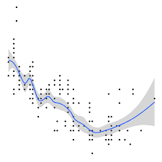
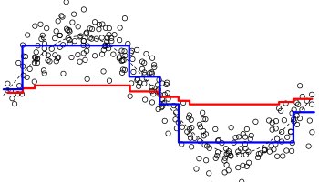
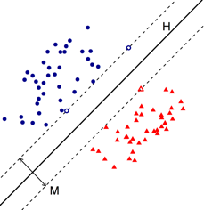
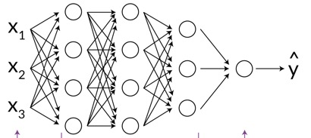
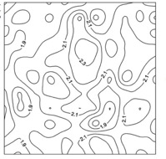
Approaches to explore
Regression-based
Tree-based
Vector-based
GLM, GLMM, GAM
Random Forest, BRT
SVM
Neural networks
Geostatistical
MLP, DNNs
Kriging, IDW
Interpolation

Slide 22
Approaches to explore
Regression-based
Tree-based
Vector-based
+structure
+uncertainty
-interactions
-overfits
+fast
+thresholds
-artifacts
-overfits
+interactions
-artifacts
-uncertainty
Random Forest, BRT
SVM
GLM, GLMM, GAM
Neural networks
Geostatistical
+big data
+complexity
-big data
-can be slow
-reproducibility
+geodata
+sparse
-slow
-oversmooth
MLP, DNNs
Kriging, IDW
Interpolation

Slide 23
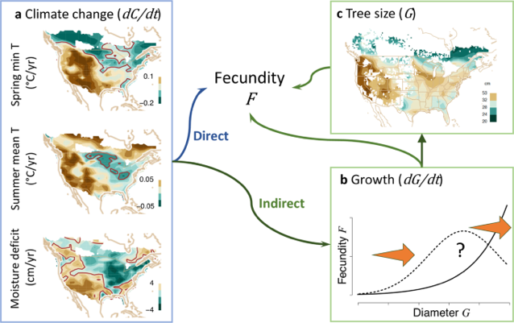
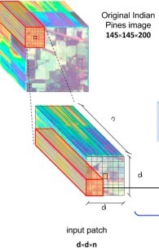
On the rise
Fast ConvNets for multispectral data
(e.g. Hyper3Dnet,
Morales et al. 2020)
Combining statistical and
process models (Clark et al. 2021)

Slide 24
Outline
Why should you use your field data to make maps?
Why?
What?
How?
What makes spatial prediction a unique challenge?
What core concepts do I need to know to succeed?
What is the basic workflow for spatial prediction?
What are some common missteps?
Case Study: vegetation deciduousness from imagery and LiDAR data.

Slide 25
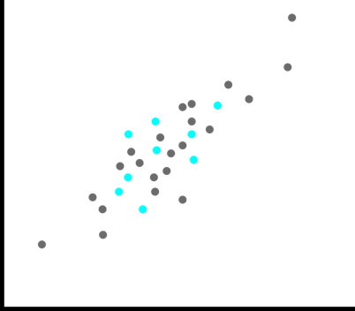
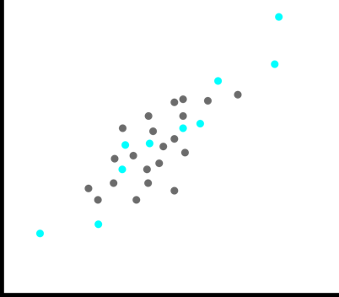
Mis-step: inadequate training data
Feature coverage matters more than sample size
y
y
x
x
Good representativeness, low coverage
Good coverage, poor representativeness

Slide 26
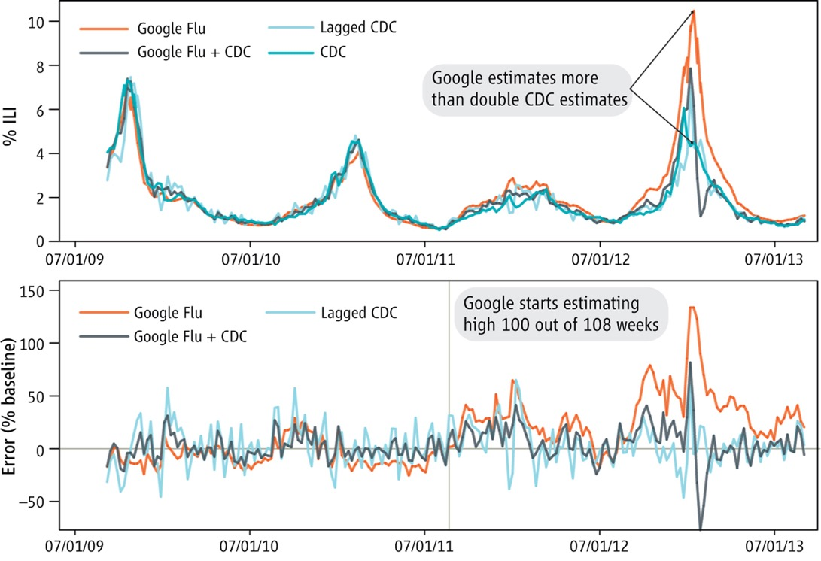
Mis-step: ignoring non-stationarity

Slide 27
Miss-step: scope and scale mismatch
Images: soilgrids.org

Slide 28
Outline
Why should you use your field data to make maps?
Why?
What?
How?
What makes spatial prediction a unique challenge?
What core concepts do I need to know to succeed?
What is the basic workflow for spatial prediction?
What are some common missteps?
Case Study: vegetation deciduousness from imagery and LiDAR data.

Slide 29
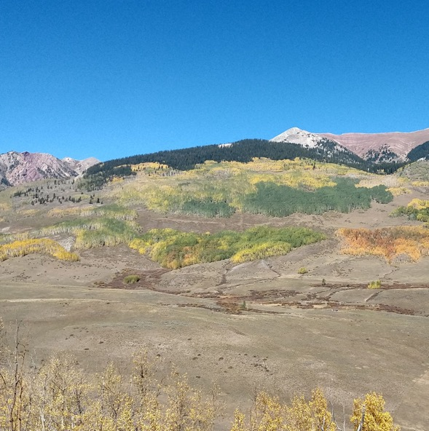
Case Study: mapping deciduousness

Slide 30
Case Study: mapping deciduousness
Collect
Training
Data
Assemble
Features
Transform
Features
Fit a
Baseline
Model
Fit, tune &
compare
models
Spatial
Prediction
Post-processing
Validate with
Independent
Data
Always
Sometimes

Slide 31
Case Study: mapping deciduousness
tidymodels.org

Slide 32
Thanks!
Contact Me:
Ian Breckheimer
ikb@rmbl.org
Twitter, Github: @ibreckhe

Slide 33
References
Asner, G. P., Brodrick, P. G., Anderson, C. B., Vaughn, N., Knapp, D. E., & Martin, R. E. (2016). Progressive forest canopy water loss during the 2012–2015 California drought. Proceedings of the National Academy of Sciences, 113(2), E249-E255.
Sofaer, H. R., Jarnevich, C. S., Pearse, I. S., Smyth, R. L., Auer, S., Cook, G. L., ... & Hamilton, H. (2019). Development and delivery of species distribution models to inform decision-making. BioScience, 69(7), 544-557.
Hengl, T., Mendes de Jesus, J., Heuvelink, G. B., Ruiperez Gonzalez, M., Kilibarda, M., Blagotić, A., ... & Kempen, B. (2017). SoilGrids250m: Global gridded soil information based on machine learning. PLoS one, 12(2), e0169748.
Chen, Y., Wu, Y., & Shen, T. J. (2018). Evaluation of the estimate bias magnitude of the Rao’s quadratic diversity index. PeerJ, 6, e5211.
Morales, G., Sheppard, J. W., Scherrer, B., & Shaw, J. A. (2020). Reduced-cost hyperspectral convolutional neural networks. Journal of Applied Remote Sensing, 14(3), 036519.
Clark, J. S., Andrus, R., Aubry-Kientz, M., Bergeron, Y., Bogdziewicz, M., Bragg, D. C., ... & Zlotin, R. (2021). Continent-wide tree fecundity driven by indirect climate effects. Nature communications, 12(1), 1-11.

